Slide 1
Heart Attack Prediction Using Different ML Models
Kapil Tandel - 130
Swati Vettiyattil - 138
Gaurav Wadhwa - 140

Slide 2
Problem Statement
A heart attack (Cardiovascular diseases) occurs when the flow of blood to the heart muscle suddenly becomes blocked.
From WHO statistics every year 17.9 million dying from heart attack.
The medical study says that human life style is the main reason behind this heart problem.
Apart from this there are many key factors which warns that the person may/maynot getting chance of heart attack.

Slide 3
About Project
In this project, we have used Heart Diseases Dataset from Kaggle for Heart Attack Prediction.
This dataset contain some medical information of patients which tells whether that person getting a heart attack chance is less or more.
Using the information, we explore the dataset and classify the target variable using different Machine Learning models to find out which algorithm is suitable for this dataset.

Slide 4
About Dataset
Source : https://www.kaggle.com/code/heart-attack-prediction-using-different-ml-models
Attribute Information : We use 13 input features and has 1 output variable
Age (Numerical) : age in years
Sex (Male /Female)
chest pain type (4 values)
resting blood pressure
serum cholesterol in mg/dl
fasting blood sugar > 120 mg/dl
oldpeak = ST depression induced by exercise relative to rest
maximum heart rate achieved
9. resting electrocardiographic results (values 0,1,2)
10. exercise induced angina
11. the slope of the peak exercise ST segment
12. number of major vessels (0-3) colored by fluoroscopy
13. thal: 0 = normal; 1 = fixed defect; 2 = reversible defect
14. target: 0= less chance of heart attack 1= more chance of heart attack

Slide 5
Algorithm Used
Extreme Gradient Boost
Support Vector Machine
K-nearest Neighbours
Random Forest
Naive Bayes
Logistic Regression
Decision Tree

Slide 6
Model Evaluation
Accuracy of different models
MODEL | ACCURACY
Extreme Gradient Boost | 85.246%
Support Vector Machine | 85.246%
K-Nearest Neighbours | 85.246%
Random Forest | 88.525%
Naive Bayes | 85.246%
Logistic Regression | 85.246%
Decision Tree | 81.967%

Slide 7
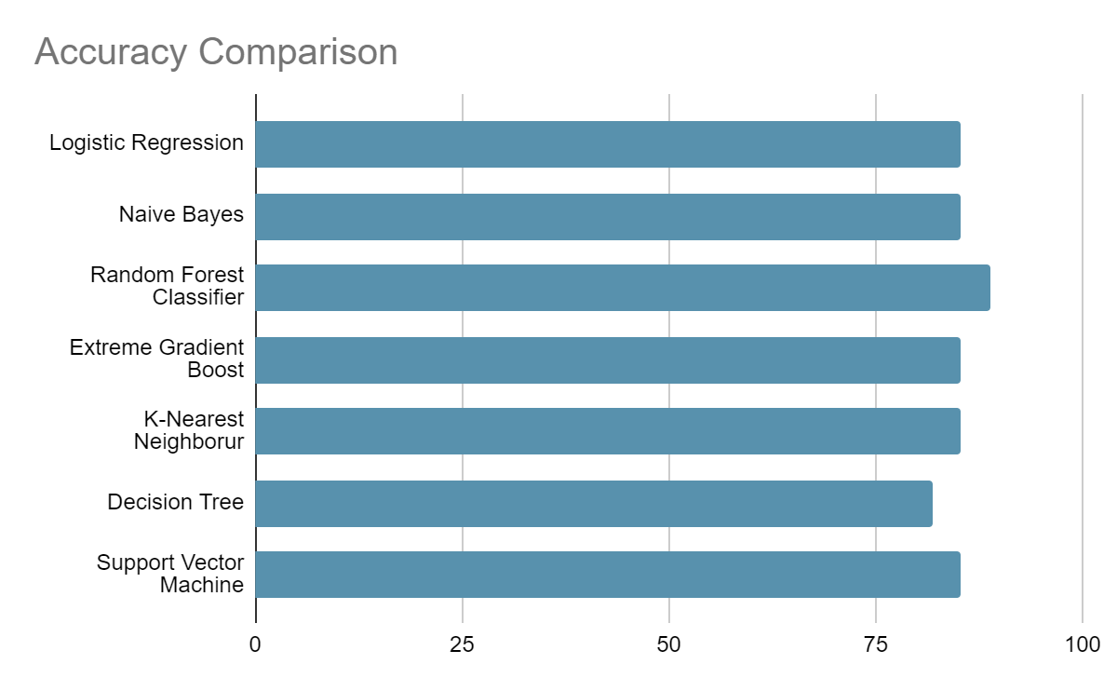
Model Evaluation
Bar Plot represent accuracy of different models

Slide 8
Conclusion
1) Random Forest yields highest accuracy of 88.524%
2) Decision Tree yields lowest accuracy of 81.967%
2) Exercise induced ST depression chest pain and increased heart rate are major symptoms of Heart attack

Slide 9
Thank You!!

